Slide 1
RESEARCH PROJECT SEMINAR CS-670-D Correctional Facility Management System
By
Alladi Jagadeshwar
Naresh Rayapati
Vikram Singh Navsinde

Slide 2
Abstract:
The Correctional Facility Management System (CFMS) aims to modernize legacy, manual systems into an efficient, secure, and web-based management solution.
Traditional ledger-based systems often result in inefficiencies, data loss, security breaches, and delays in decision-making. CFMS addresses these challenges by automating offender tracking from admission to release, ensuring data integrity, and enhancing security measures.
Leveraging technologies like Python, MySQL, and AWS, the system provides centralized offender records, streamlined workflows, and real-time data access, enabling faster, more reliable operations for correctional facilities.

Slide 3
Problem:
In the current system, the complete data storage and maintenance is carried out manually.
This requires more man power and is a time-consuming process. In some cases, there may be chances of making errors in data representation or storage which leads to hassles.
In the current system, if the data is increased, it is difficult to organize and retrieve the accurate data when required.
Another important drawback is, the manual systems will have the less scope for quick data retrieval from huge data stored.
Another major problem in the current system is the maximum chances of data compromisation as each information is represented and stored in the paper.

Slide 4
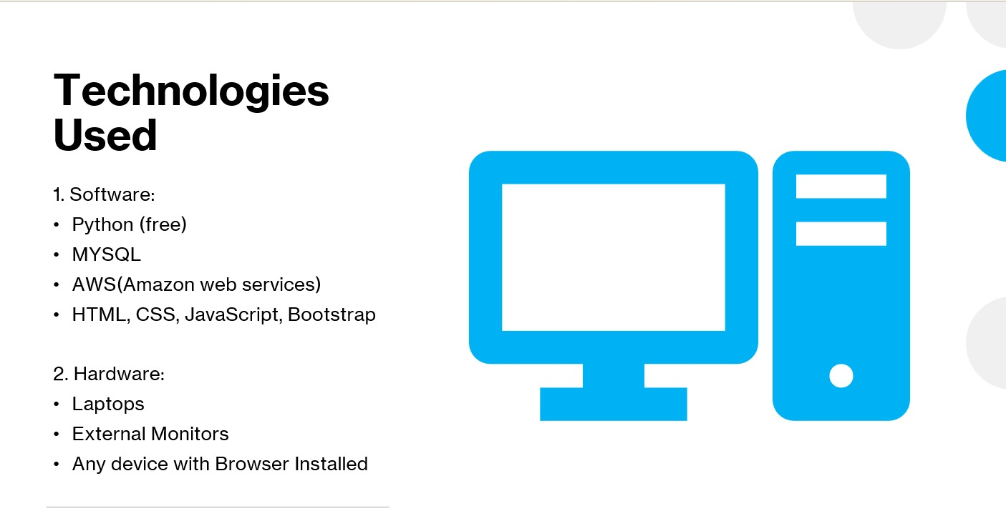
Requirements :

Slide 5
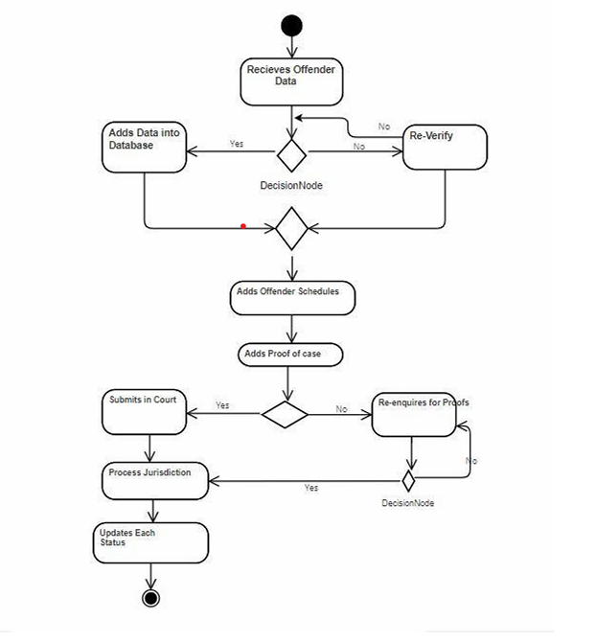
Activity Diagram

Slide 6
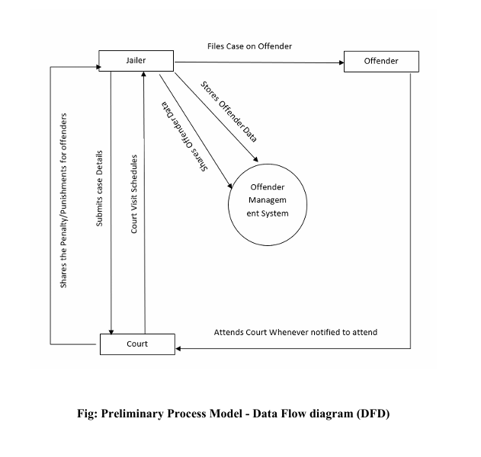
Preliminary Process Model- DFD

Slide 7
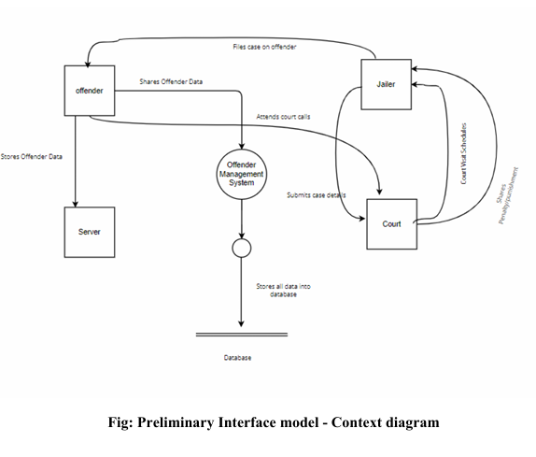
Preliminary Interface model-Context diagram:

Slide 8
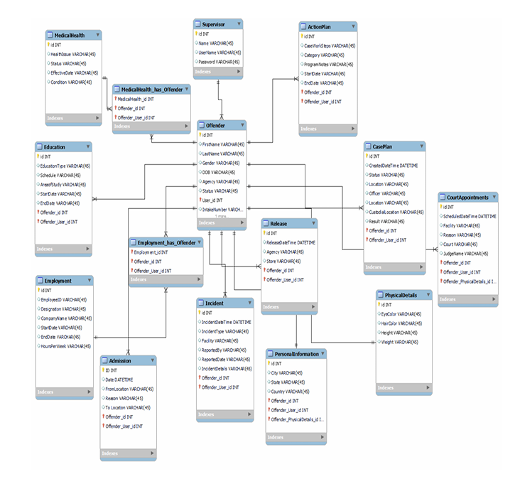
Entity Relationship Diagram;

Slide 9
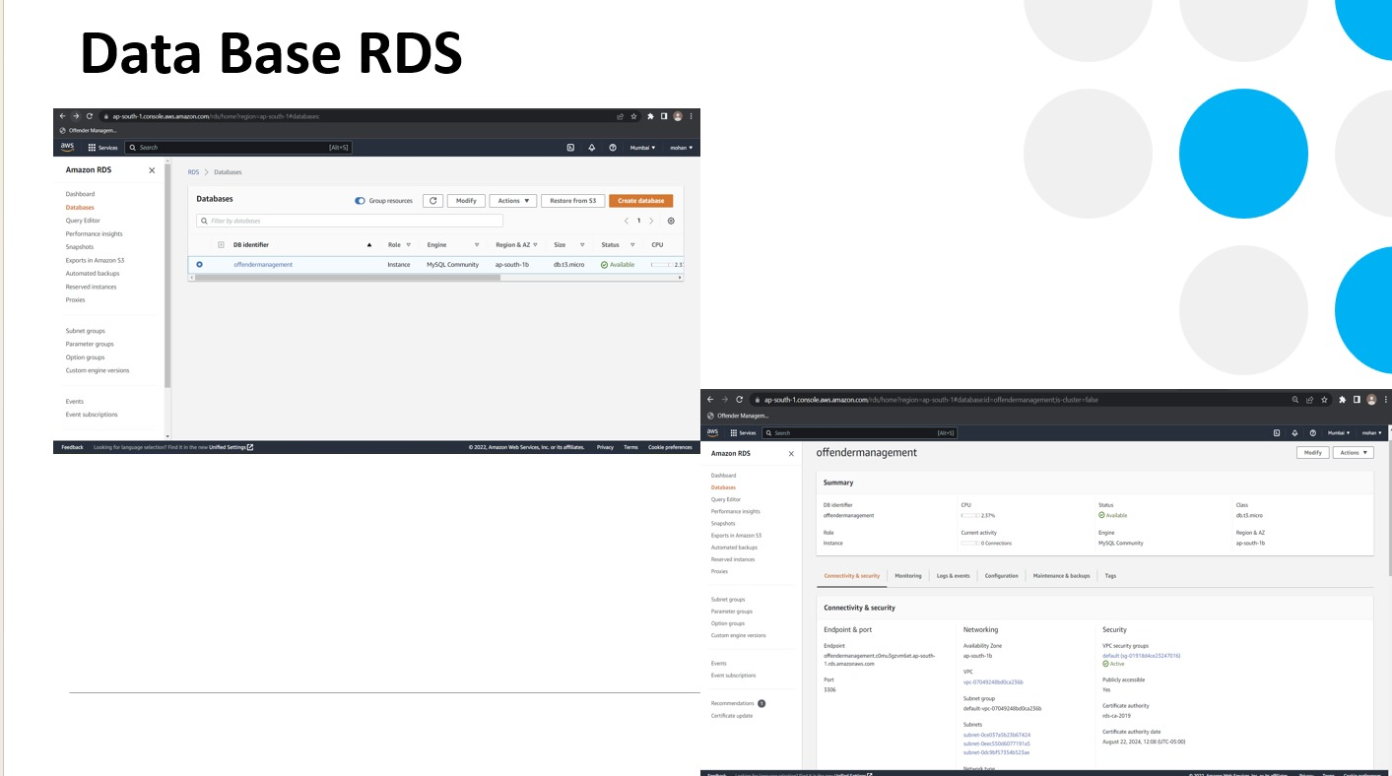

Slide 10
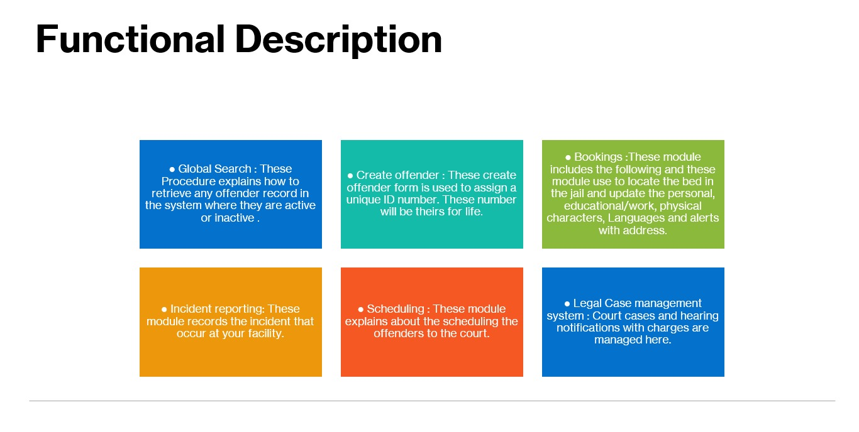

Slide 11
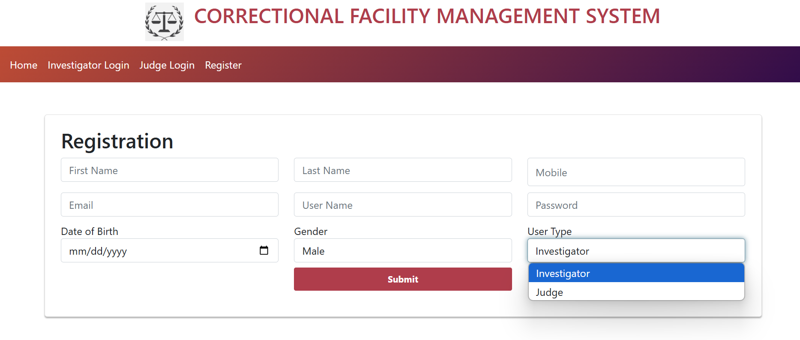
Registration Page:

Slide 12
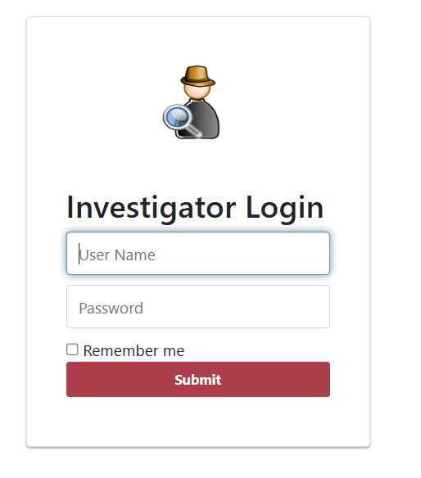
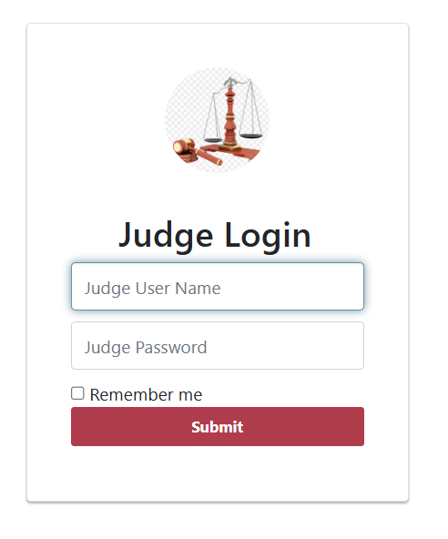
Types of login:

Slide 13
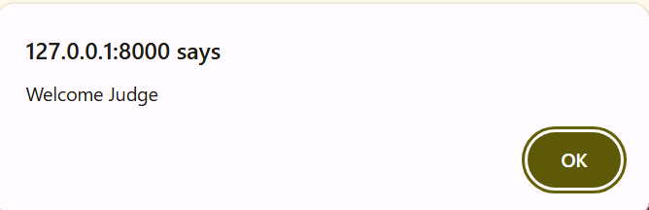
Judge login:
This pop up is shown when a registered judge is logged into the portal

Slide 14
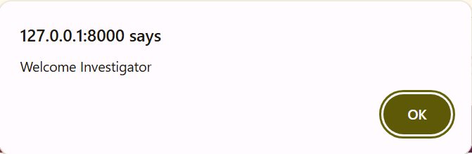
Investigator login:
This pop up is shown when a registered Investigator is logged into the portal

Slide 15
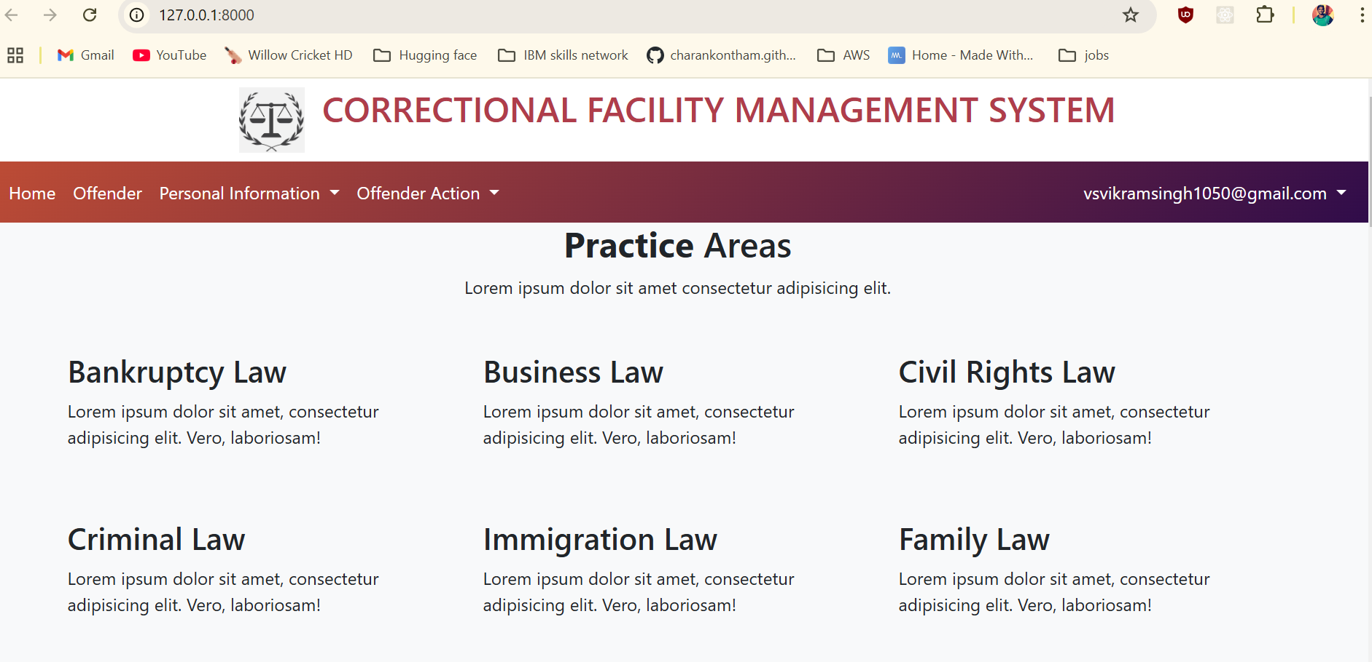
Home page
This is the landing page of the CFMS.
In this page we can see about the different laws and the services provided by CFMS.
This page consists of heading, navbar, body and footer.
Navbar is used for navigating to other pages of the website.

Slide 16
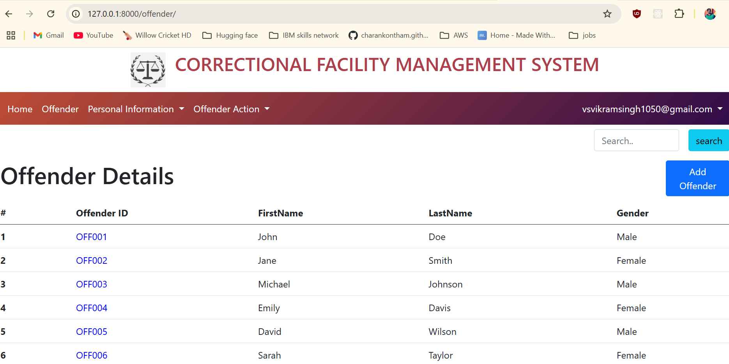
Offender page
We are navigated to this page when we click Offender in the Navbar.
This page has the Offender details like Offender ID, Firstname, Lastname, Gender.
We have a search option also so that we can get Personal Info of particular Offender Id which is searched.
Add Offender is used to add an offender to the list.

Slide 17
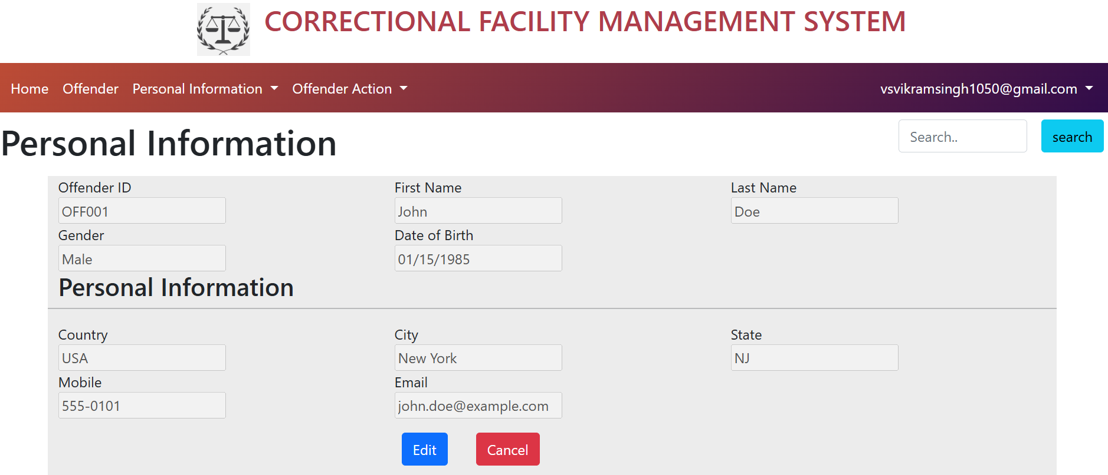
Personal Info Page
We can find the personal information of any offender by searching with his Offender ID.
In this page we can see the personal info of offender like his name, DOB and his Address, Mobile, email.
We can also update the personal information of any offender using the edit option.

Slide 18
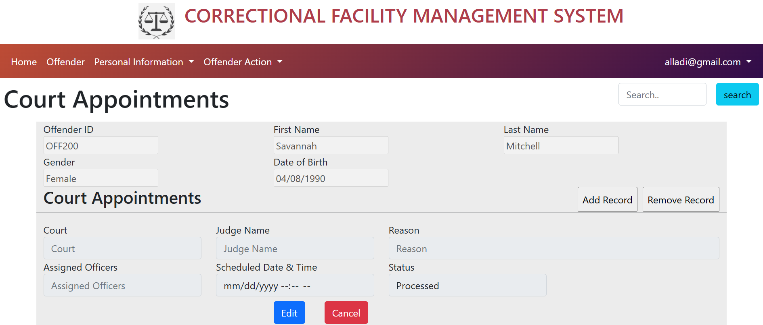
Court Appointment page
In this page we have details of the searched offender along with their court appointments.
A Judge can add record for the Court appointment using the ‘Add Record’ button
He can also change the status of the case using the ‘edit’ button.
He can also remove the record using ‘Remove record’ button.

Slide 19
Thank you Any Questions?

